Slide 1
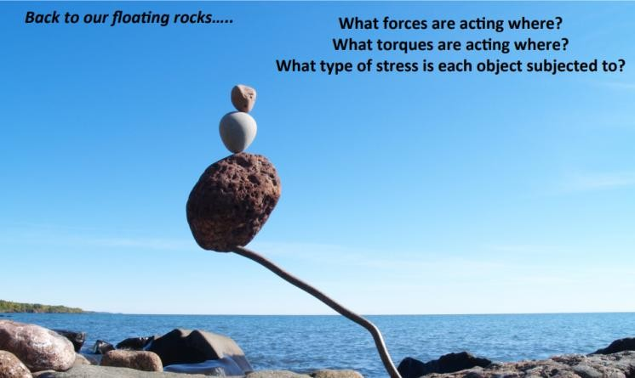
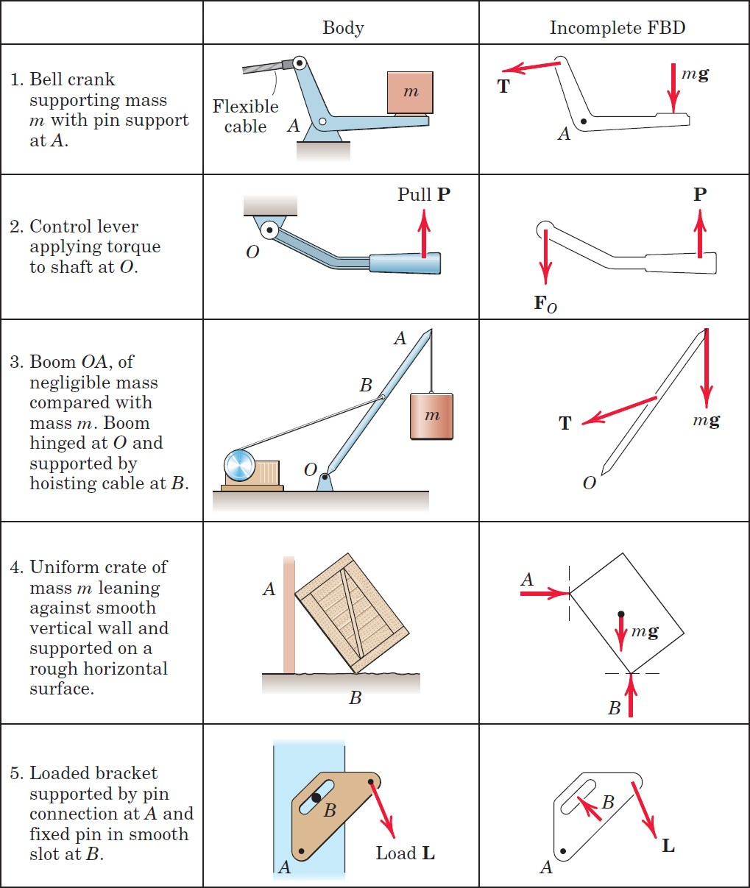
1.2 Stress and Equiliberum
FREE-BODY DIAGRAM EXERCISES
In each of the five following examples, the body to be isolated is shown in the left-hand diagram, and an incomplete free-body diagram (FBD) of the isolated body is shown on the right. Add whatever forces are

Slide 2
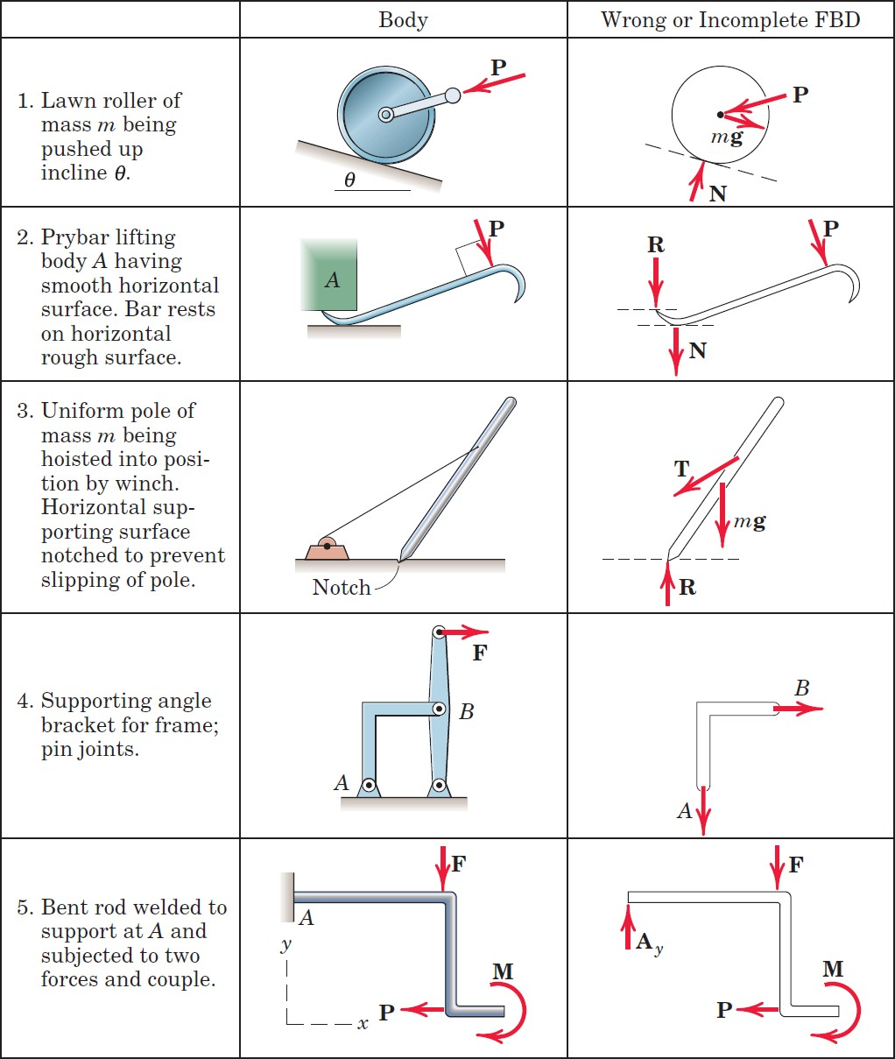

Slide 3
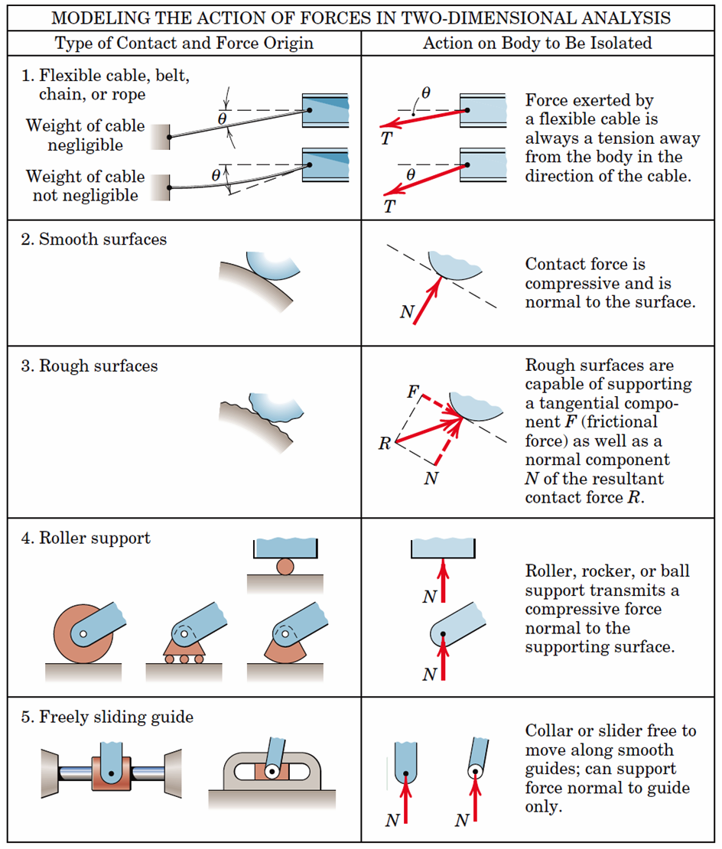
Equilibrium Conditions
We defined equilibrium as the condition in which the resultant of all forces and moments acting on a body is zero. Stated in another way, a body is in equilibrium if all forces and moments applied to it are in balance
𝐹_{𝑥} = 0, 𝐹_{𝑦} = 0, 𝑀 = 0,

Slide 4
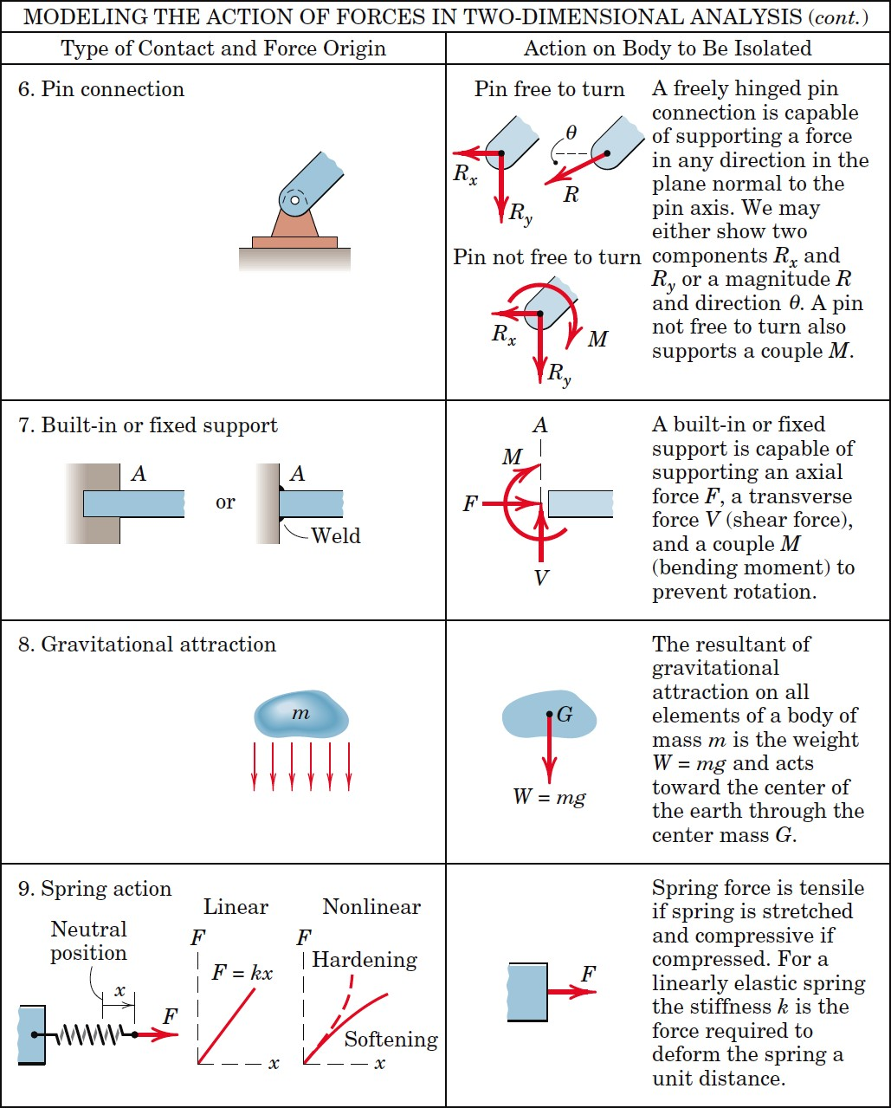

Slide 5
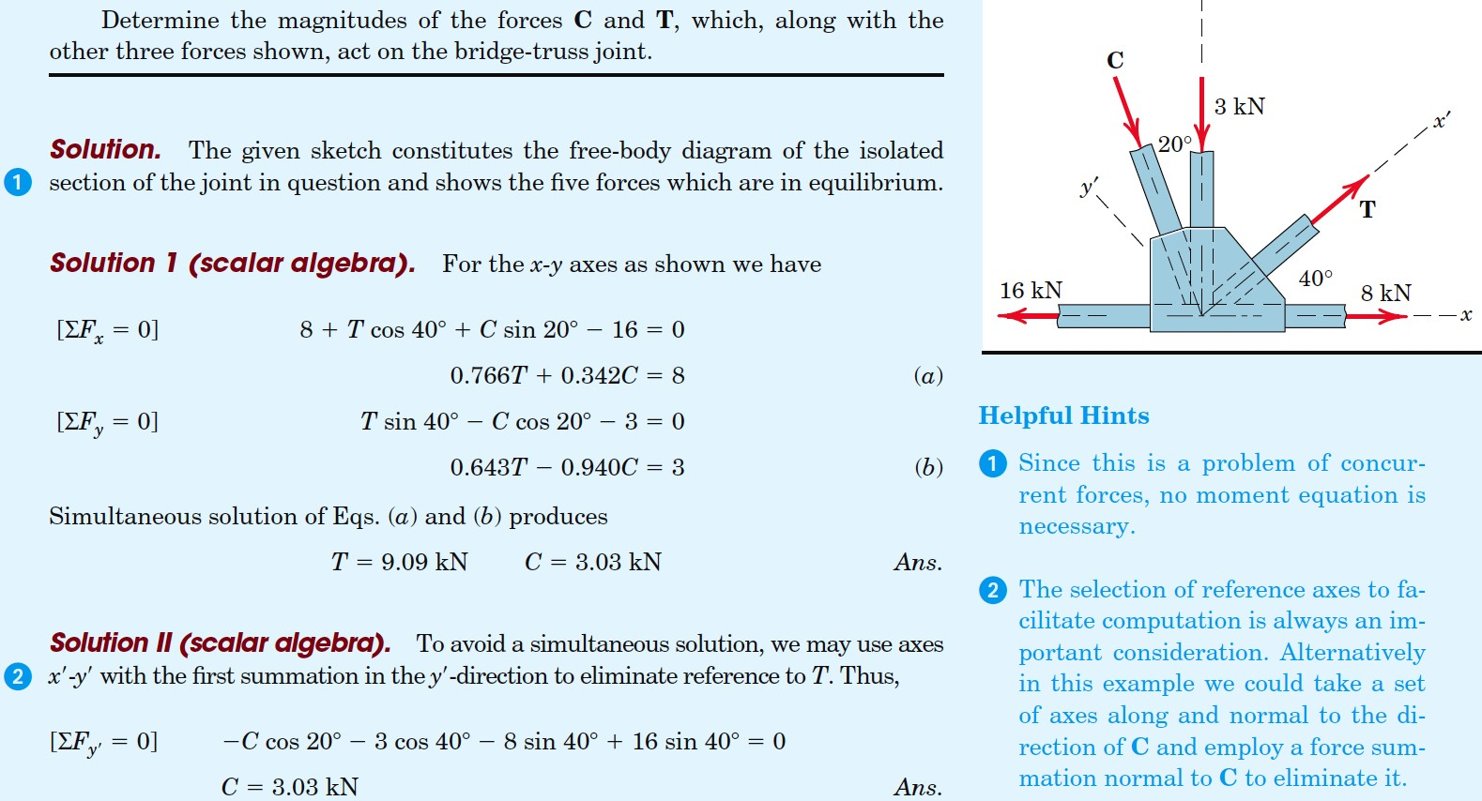
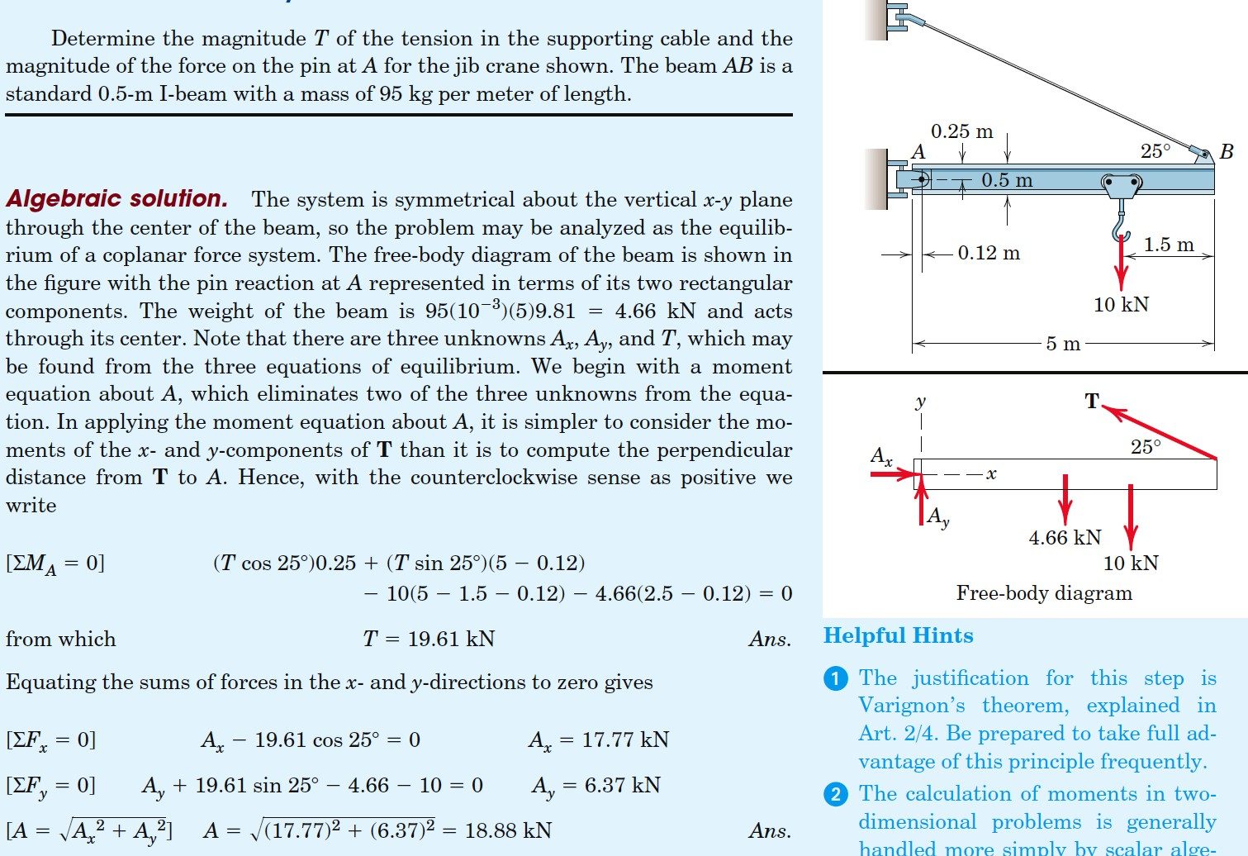
Example
Example

Slide 6
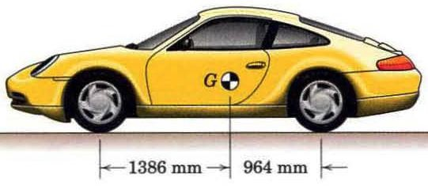
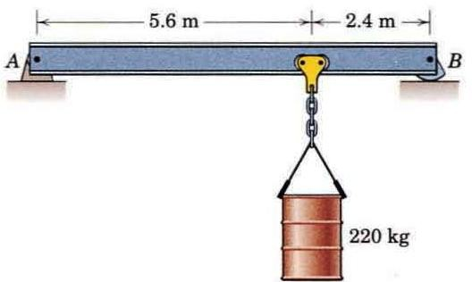
Example
The mass center G of the 1400-kg rear-engine car is located as shown in the figure. Determine the normal force under each tire when the car is in equilibrium. State any assumptions.
Example
The 450-kg uniform I-beam supports the load shown. Determine the reactions at the supports.

Slide 7
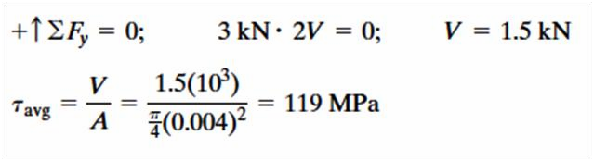
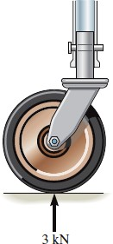
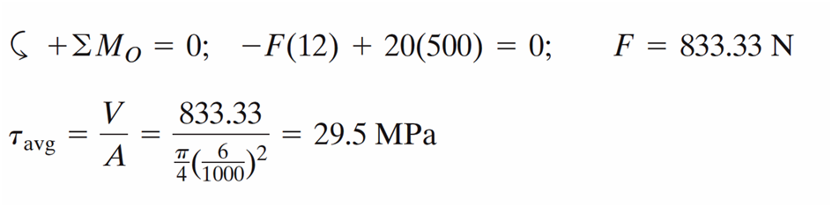
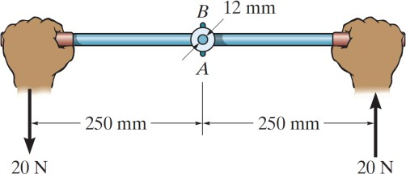


Example
The supporting wheel on a scaffold is held in place on the leg using a 4-mm-diameter pin as shown. If the wheel is subjected to a normal force of 3 kN, determine the average shear stress developed in the pin. Neglect friction between the inner scaffold puller leg and the tube used on the wheel.
V
V
3KN
Example
The lever is held to the fixed shaft using a tapered pin AB, which has a mean diameter of 6 mm. If a couple is applied to the lever, determine the average shear stress in the pin between the pin and lever
F 12mm
o
500mm
F
20N

